Slide 1
NEW TEA SHOP IN PARIS

Slide 2
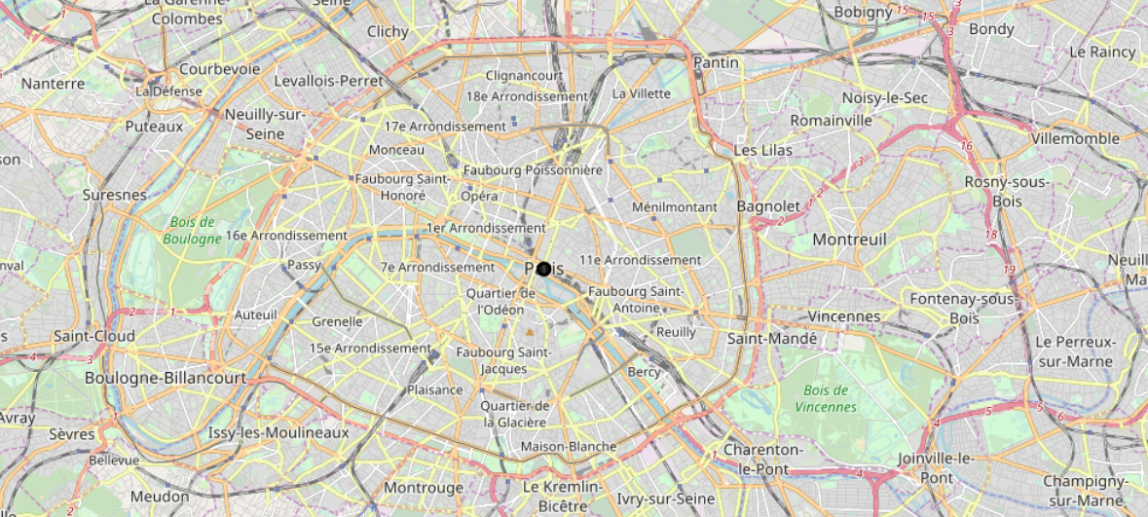
As a Chinese student living in Paris, I like to eat Chinese food and drink Bubble Tea (just like most Chinese students). But not every Chinese restaurant has a tea shop nearby. Sometimes it takes more than 30 minutes to reach the tea shop after the meal. With the increasing number of Chinese students studying in Paris, the number of tea shops will increase. In this project, I combined the information of the existing Chinese restaurants and tea shops in Paris, and recommended the address for opening the new bubble tea shop for investment merchants. Investors in the restaurant industry in Paris will be very emotional about this report.

Slide 3
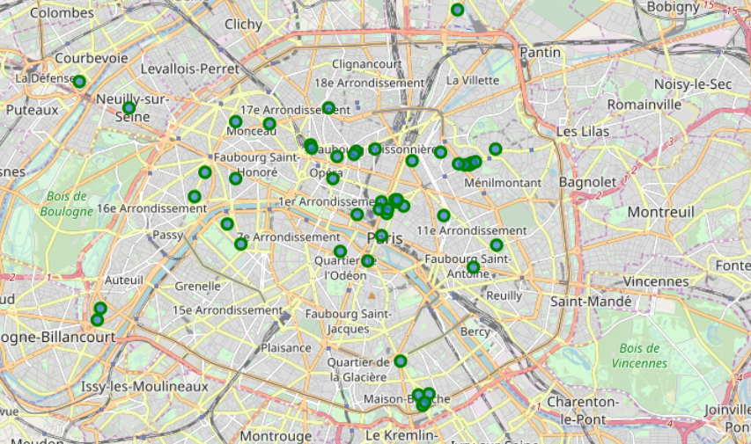
Chinese Restaurants In Paris

Slide 4
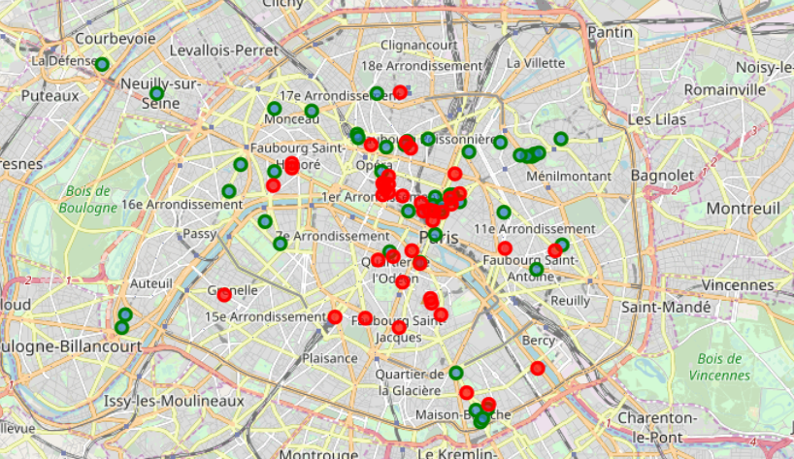
Tea Shop In Paris

Slide 5
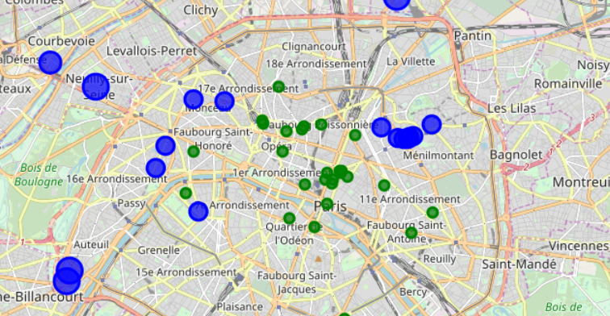
Conclusion
Blue dots are the recommended places to open a new tea shop. Opening a new tea shop in these places will not only ensure the number of customers (the customers who go to the Chinese restaurant are our potential customers), but also avoid the competition of existing tea shops.

